Slide 1

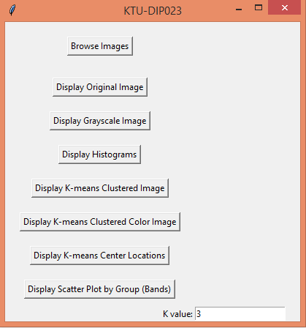
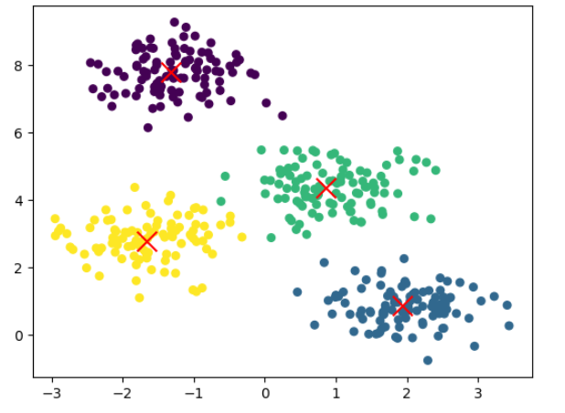
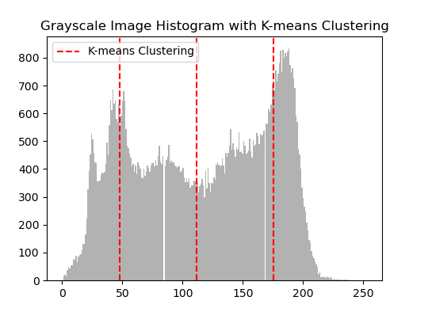
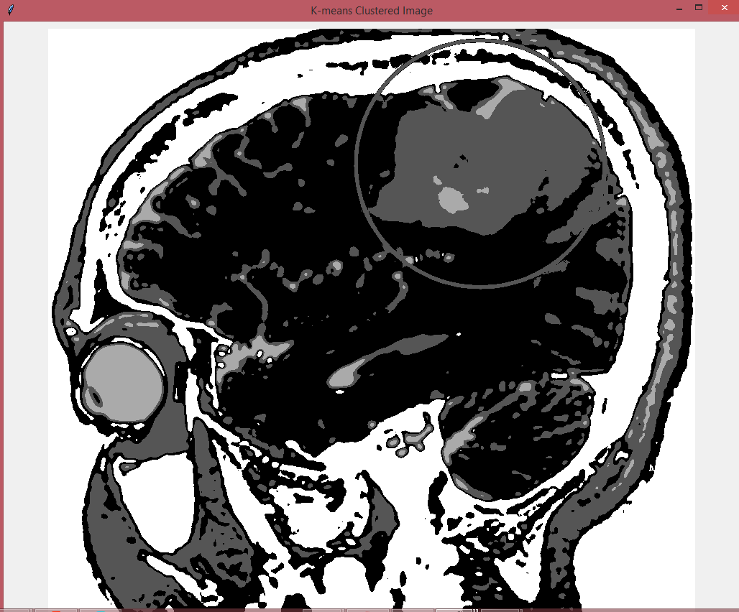
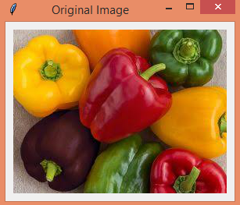
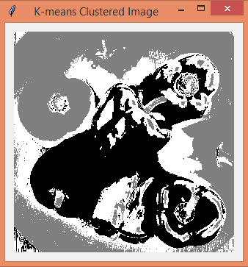
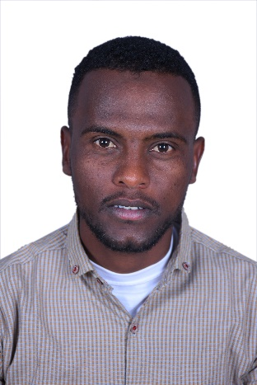
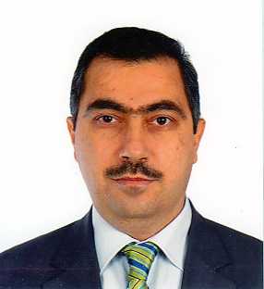
KARADENİZ TEKNİK ÜNİVERSİTESİ
FEN BİLİMLERİ ENSTİTÜSÜ
HARİTA MÜHENDİSLİĞİ ANABİLİM DALI
(BIL5040- Bilgisayarla Görme)
KTU-DIP023: An Interactive Tool for K-means Clustering and Image Analysis
Jun. 02, 2023 @ 03:30 P.M.
Advisor:
(Prof. MURAT EKİNCİ)
Osman O. Ahmed Ibrahim

Slide 2
CONTENT:
Conclusion
INTRODUCTION
G
A
Problem Statement
Applications
F
B
E
C
KTU-DIP Tool code
D
K-Means Clustering Algorithm
KTU-DIP Tool

Slide 3
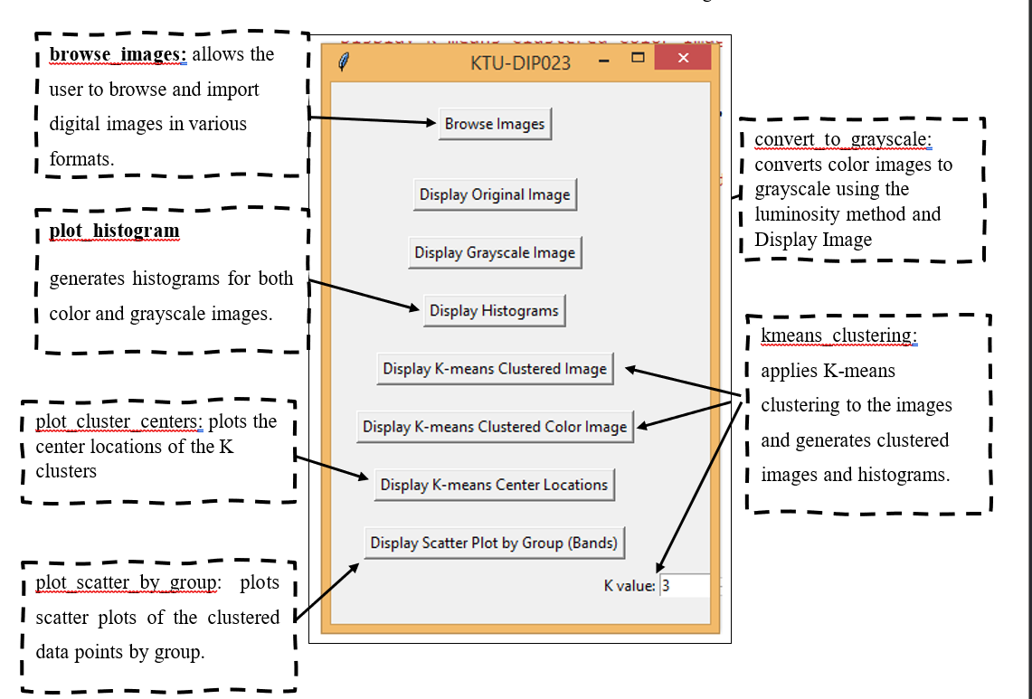

Slide 4
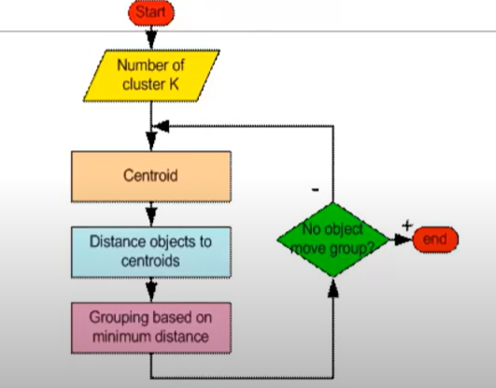
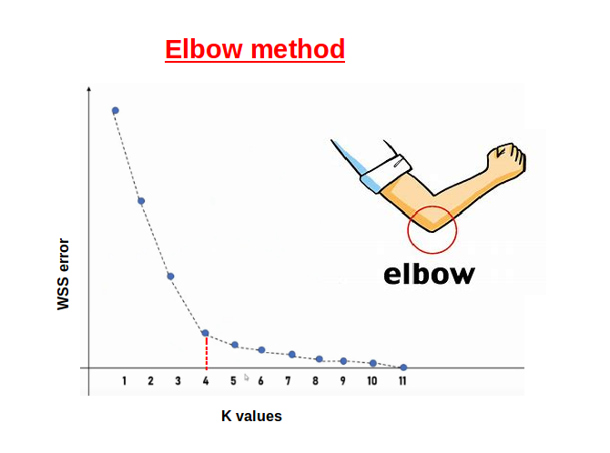
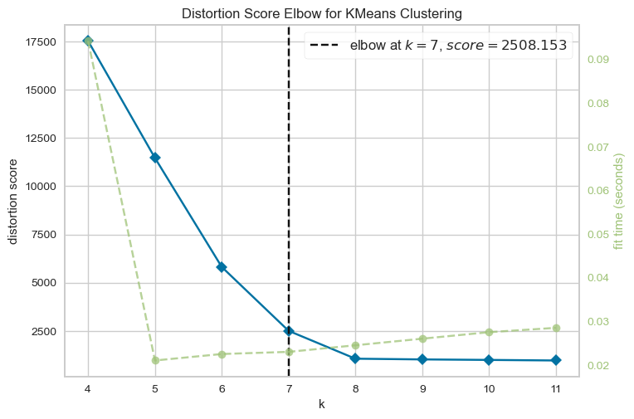


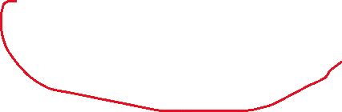
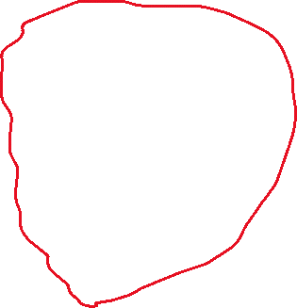
WSS Plot also called “Within Sum of Squares” is another solution under the K-Means algorithm which helps to decide the value of K (number of clusters). The values taken to plot the WSS plot will be the variance from each observation in the clusters to its centroid, summing up to obtain a value.

Slide 5
Individual | Variable 1 | Variable 2 | Centroid
1 | 1 | 1 | C1
2 | 1.5 | 2
3 | 3 | 4
4 | 5 | 7 | C2
5 | 3.5 | 5
6 | 4.5 | 5
7 | 3.5 | 4.5
Lit1
 | Centroid-1 | Centroid-2
1 | 0.00 | 7.21
2 | 1.12 | 6.10
3 | 3.61 | 3.61
4 | 7.21 | 0.00
5 | 4.72 | 2.50
6 | 5.32 | 2.06
7 | 4.30 | 2.92
 | Centroid-1 | Centroid-2
1 | 1.57 | 5.38
2 | 0.47 | 4.28
3 | 2.03 | 1.78
4 | 5.64 | 1.85
5 | 3.14 | 0.73
6 | 3.77 | 0.53
7 | 2.73 | 1.08
New C1 | 1.83 | 2.33
New C2 | 4.13 | 5.38
New C1 | 1.25 | 1.50
New C2 | 3.90 | 5.10
 | Centroid-1 | Centroid-2
1 | 0.56 | 5.02
2 | 0.56 | 3.92
3 | 3.05 | 1.42
4 | 6.66 | 2.20
5 | 4.16 | 0.41
6 | 4.78 | 0.61
7 | 3.75 | 0.72

Slide 6
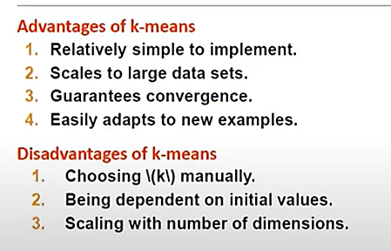

Slide 7
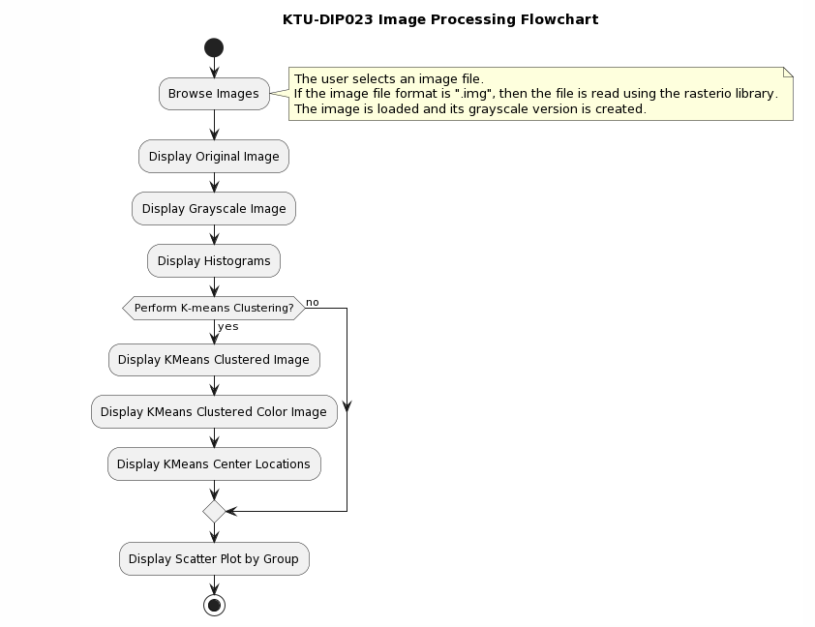

Slide 8
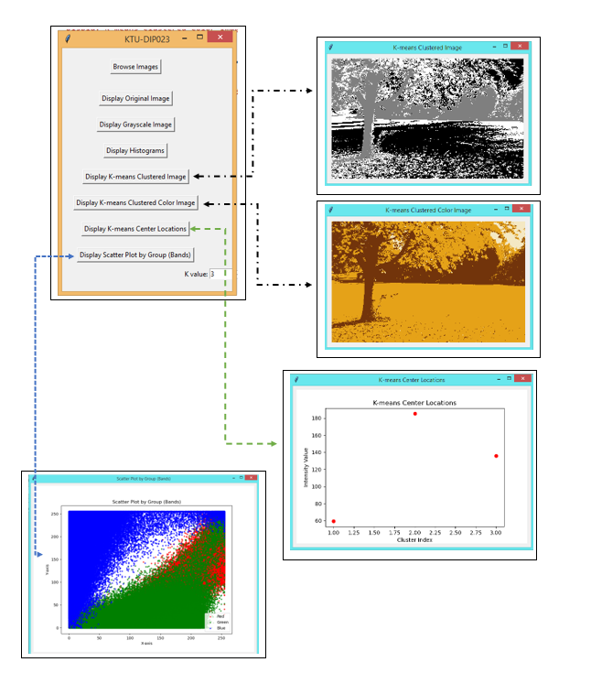
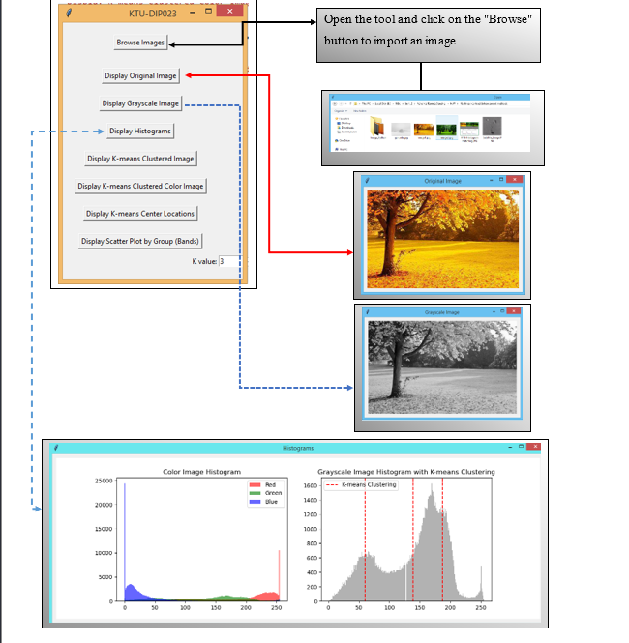

Slide 9
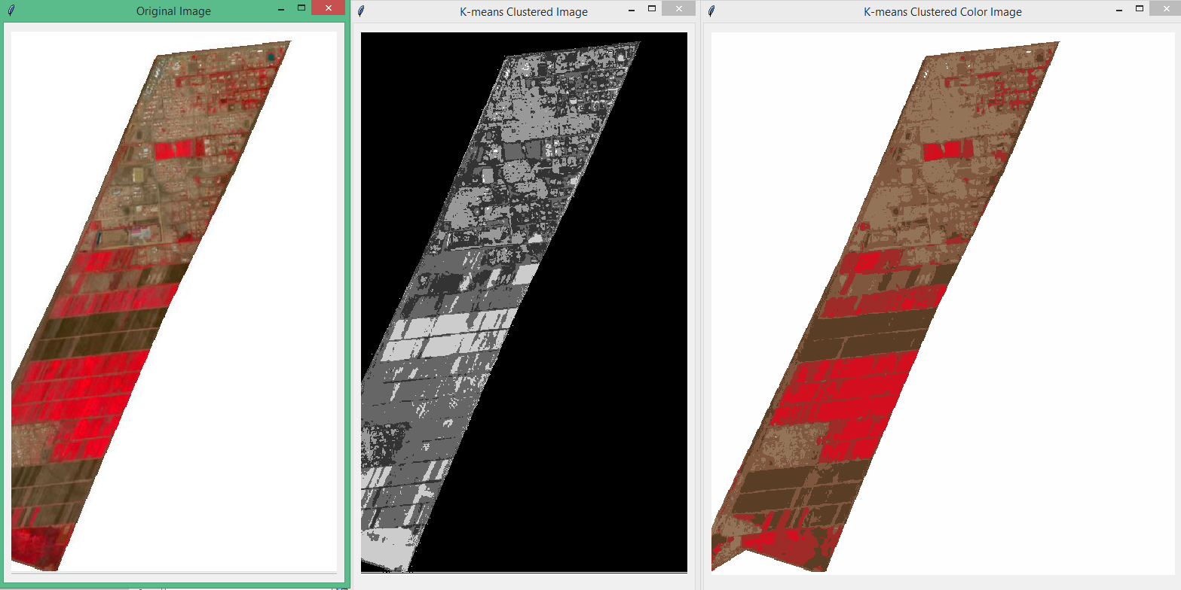
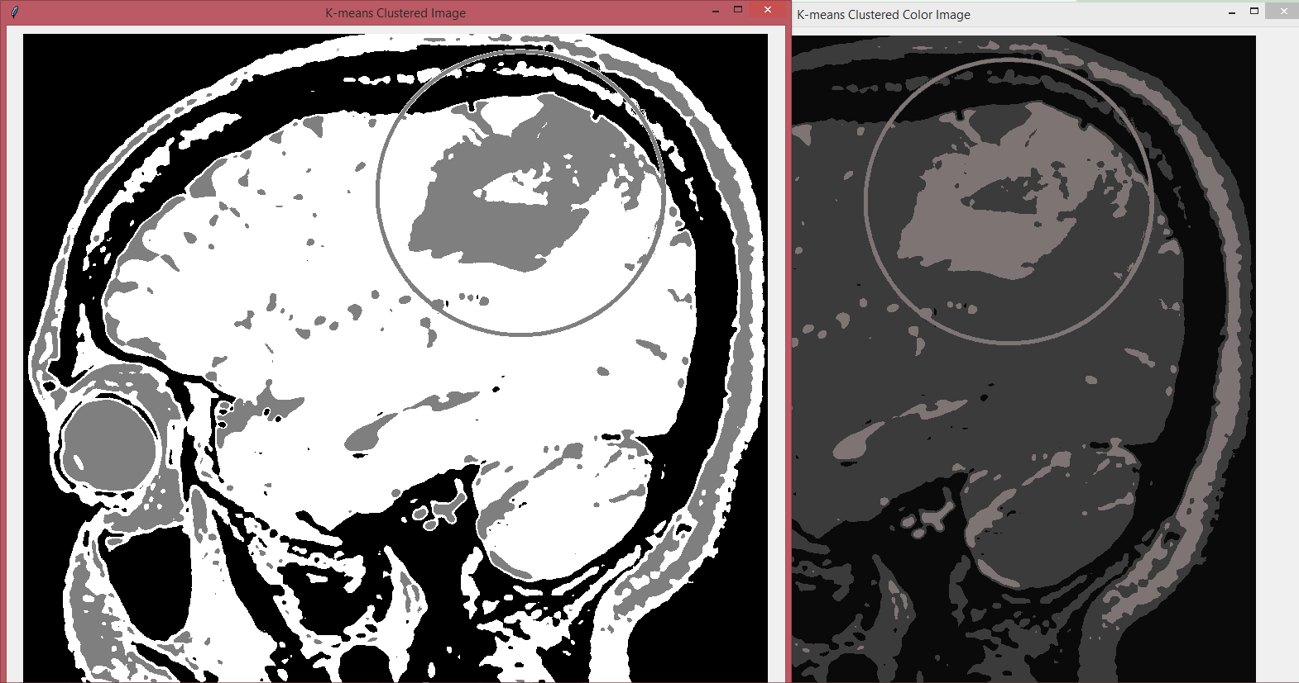
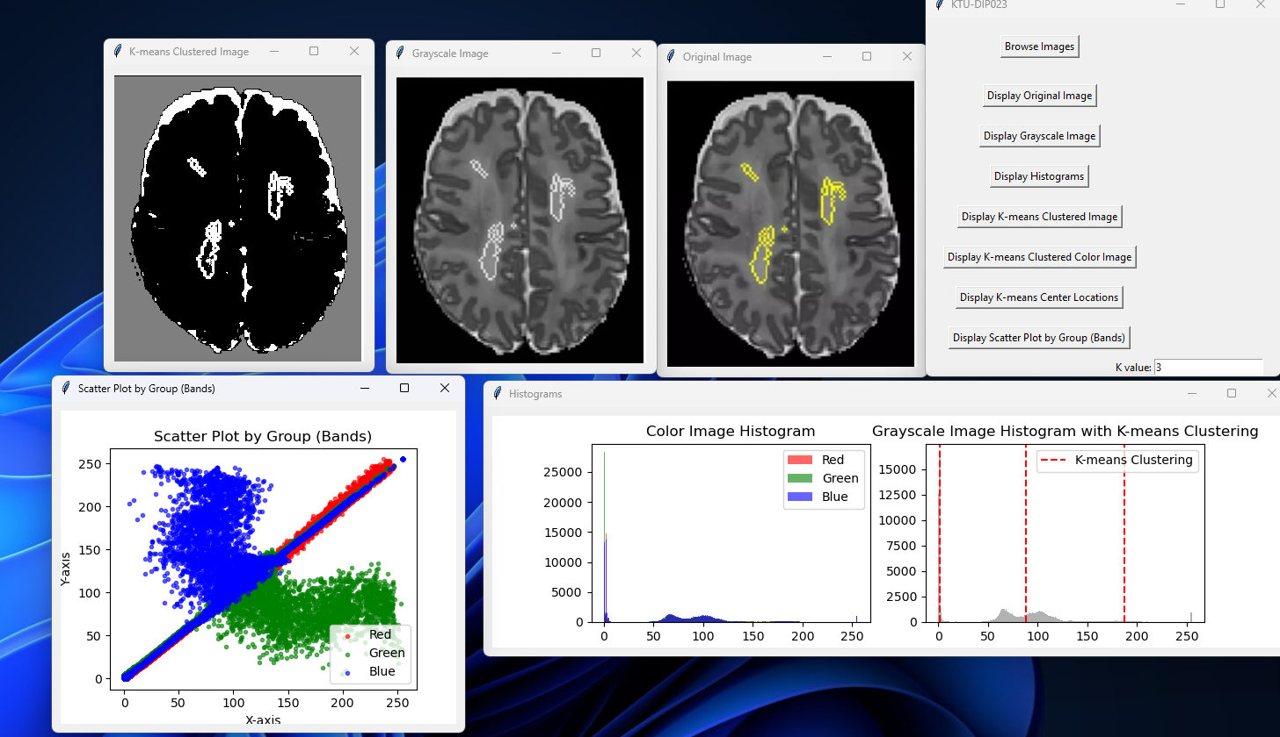

Slide 11
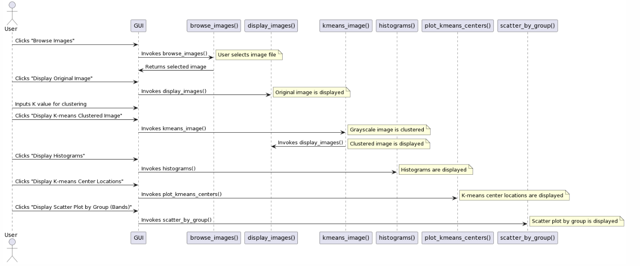

Slide 12

import tkinter as tk
from tkinter import filedialog
from PIL import Image, ImageOps, ImageTk
import numpy as np
import matplotlib.pyplot as plt
from matplotlib.backends.backend_tkagg import FigureCanvasTkAgg
from sklearn.cluster import KMeans
import rasterio
from rasterio.plot import reshape_as_image

Slide 13
def browse_images():
file_path = filedialog.askopenfilename(filetypes=[("Image files", "*.jpg;*.jpeg;*.png;*.bmp;*.tiff;*.img")])
if file_path:
global color_img, gray_img
if file_path.lower().endswith('.img'):
with rasterio.open(file_path) as src:
color_arr = reshape_as_image(src.read())
color_arr = (color_arr * (255.0 / color_arr.max())).astype(np.uint8) # Add this line
color_img = Image.fromarray(color_arr)
else:
color_img = Image.open(file_path)
gray_img = ImageOps.grayscale(color_img)

Slide 14
def display_original_image():
display_images(color_img, "Original Image")
def display_grayscale_image():
display_images(gray_img, "Grayscale Image")
def display_kmeans_image():
kmeans_image(gray_img, int(k_value_entry.get()))
def display_color_kmeans_image():
kmeans_color_image(color_img, int(k_value_entry.get()))
def display_images(img, title):
window = tk.Toplevel(root)
window.title(title)
photo = ImageTk.PhotoImage(img)
label = tk.Label(window, image=photo)
label.image = photo
label.pack(padx=10, pady=10)

Slide 15
def display_histograms():
histograms(color_img, gray_img, int(k_value_entry.get()))
def kmeans_image(gray_img, k_value):
gray_arr = np.array(gray_img)
kmeans = KMeans(n_clusters=k_value)
pixel_values = gray_arr.reshape(-1, 1)
kmeans.fit(pixel_values)
labels = kmeans.labels_.reshape(gray_arr.shape)
clustered_img = Image.fromarray((labels * 255 // (k_value - 1)).astype(np.uint8), mode='L')
display_images(clustered_img, "K-means Clustered Image")

Slide 16
def kmeans_color_image(color_img, k_value):
color_arr = np.array(color_img)
kmeans = KMeans(n_clusters=k_value)
pixel_values = color_arr.reshape(-1, 3)
kmeans.fit(pixel_values)
labels = kmeans.labels_.reshape(color_arr.shape[:2])
clustered_arr = np.zeros_like(color_arr)
for i in range(k_value):
clustered_arr[labels == i] = kmeans.cluster_centers_[i]
clustered_img = Image.fromarray(clustered_arr.astype(np.uint8))
display_images(clustered_img, "K-means Clustered Color Image")

Slide 17
def histograms(color_img, gray_img, k_value):
histogram_window = tk.Toplevel(root)
histogram_window.title("Histograms")
fig, axs = plt.subplots(1, 2, figsize=(12, 4))
# Color Image Histogram
color_arr = np.array(color_img)
colors = ("r", "g", "b")
for i, color in enumerate(colors):
axs[0].hist(color_arr[..., i].ravel(), bins=256, color=color, alpha=0.6)
axs[0].set_title("Color Image Histogram")
axs[0].legend(['Red', 'Green', 'Blue'])

Slide 18
# Grayscale Image Histogram with K-means Clustering
gray_arr = np.array(gray_img).ravel()
axs[1].hist(gray_arr, bins=256, color='gray', alpha=0.6)
kmeans = KMeans(n_clusters=k_value)
kmeans.fit(gray_arr.reshape(-1, 1))
centers = kmeans.cluster_centers_.squeeze()
for center in centers:
axs[1].axvline(center, color='r', linestyle='--')
axs[1].set_title("Grayscale Image Histogram with K-means Clustering")
axs[1].legend(['K-means Clustering'])
canvas = FigureCanvasTkAgg(fig, master=histogram_window)
canvas.draw()
canvas.get_tk_widget().pack(side="bottom", padx=10, pady=10)

Slide 19
def display_kmeans_centers():
plot_kmeans_centers(gray_img, int(k_value_entry.get()))
def plot_kmeans_centers(gray_img, k_value):
gray_arr = np.array(gray_img).ravel()
kmeans = KMeans(n_clusters=k_value)
kmeans.fit(gray_arr.reshape(-1, 1))
centers = kmeans.cluster_centers_.squeeze()
centers_window = tk.Toplevel(root)
centers_window.title("K-means Center Locations")
fig, ax = plt.subplots(figsize=(6, 4))
ax.scatter(range(1, k_value + 1), centers, c='r', marker='o')
ax.set_title("K-means Center Locations")
ax.set_xlabel("Cluster Index")
ax.set_ylabel("Intensity Value")
canvas = FigureCanvasTkAgg(fig, master=centers_window)
canvas.draw()
canvas.get_tk_widget().pack(side="bottom", padx=10, pady=10)

Slide 20
def display_scatter_by_group():
scatter_by_group(color_img)
def scatter_by_group(color_img):
color_arr = np.array(color_img)
r_band = color_arr[..., 0].ravel()
g_band = color_arr[..., 1].ravel()
b_band = color_arr[..., 2].ravel()
scatter_window = tk.Toplevel(root)
scatter_window.title("Scatter Plot by Group (Bands)")
fig, ax = plt.subplots(figsize=(8, 6))
ax.scatter(r_band, g_band, c='r', marker='.', alpha=0.6, label='Red')
ax.scatter(g_band, b_band, c='g', marker='.', alpha=0.6, label='Green')
ax.scatter(b_band, r_band, c='b', marker='.', alpha=0.6, label='Blue')
ax.set_title("Scatter Plot by Group (Bands)")
ax.set_xlabel("X-axis")
ax.set_ylabel("Y-axis")
ax.legend()
canvas = FigureCanvasTkAgg(fig, master=scatter_window)
canvas.draw()
canvas.get_tk_widget().pack(side="bottom", padx=10, pady=10)

Slide 21
